Slide 1
Status Report:
T20 Win Predictor
CS 403

Slide 2
Overview
Problem Statement- Motivation
Formulation
Approach
Literature Survey
Future Plans for completion

Slide 3
Problem Statement
Motivation
Cricket is full of uncertainties, especially in the shortest format like IPL
We are passionate about cricket
We will learn about the different classification models , their performance and behaviour
We will learn about various hyper-parameter optimization techniques

Slide 4
Problem Statement
Formulation
Given the scoreboard of the match we try to predict the outcome.
We look at match scoreboard after every over, instead of predicting at each ball of an over.
We extract the following features from the ball by ball data to use in our classifier.
For each over, we calculate runs scored and number of dismissals in that over.
Using information of current over we update the innings score, innings wickets, current run rate, required run rate, remaining target etc.

Slide 5
Approach
We have used the multi-layer perceptron (MLP) classifier to get expected classification
We have used scikit-learn library’s implementation of the MLP classifier
The neural network has 2 hidden layers with 12 nodes each.

Slide 6
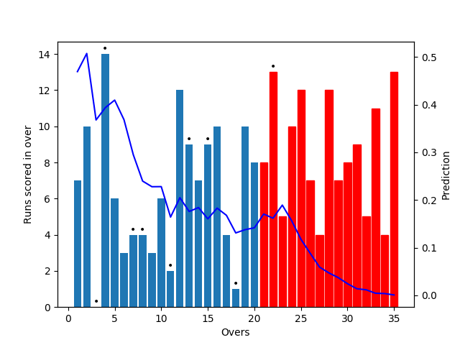
Sample Output
Actual match stats at http://www.iplt20.com/archive/2008/3

Slide 7
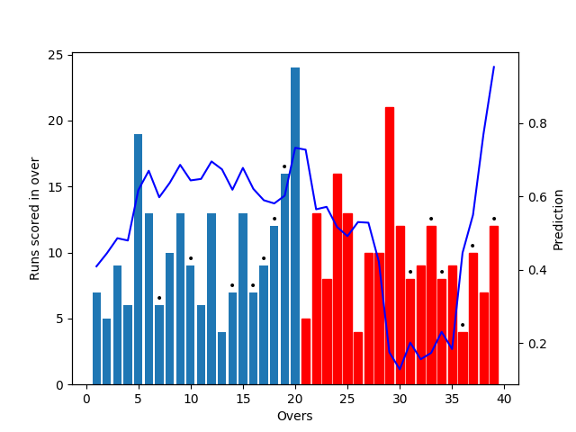
Actual match stats at http://www.iplt20.com/match/2016/60

Slide 8
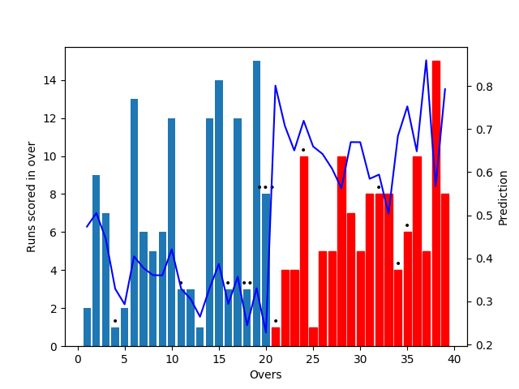
Actual match stats at http://www.iplt20.com/match/2016/40

Slide 9
Literature Survey
https://arxiv.org/ftp/arxiv/papers/1511/1511.05837.pdf
Problem Statement : Predicting the outcome of a English County T20 match.
2 Models were created one using only team features and other using both team and player features
Features of both models were then selected using different correlation scores.
Classification techniques like Naive Bayes and Random Forests were used to predict
http://pages.cs.wisc.edu/~shruthir/Documents/MachineLearning_Final_Report.pdf
Problem Statement : Predicting the outcome of a T20 match
Features for each player: Average Runs, Strike Rate, etc for batsmen and Average wickets per match, Economy rate, Strike Rate etc. for bowlers
Classifiers used : Decision Trees, Naive Bayes, Random Forests, SVM, Adaboost
Evaluation : 10 fold cross validation on IPL data set
Another approach using player ratings was employed, which considered bowler-batsmen interaction and time scaling

Slide 10
Future Plans
Following are the approaches described in the literature that we will try to implement in the future
Generate the features of each team based on their past performances, like win percentage, batting average, bowling average, batting run rate, bowling economy etc.
Generate the features of each player for batting : SR, average, no. of 30s, no. of 4s, no of 6s, and for bowling : SR, economy, average, 3 wicket hauls.
Use different techniques SVM, Elastic nets, Adaboost, ensemble learning

